Slide 1
Dpay wallet
Online payment service
Presented By-
Dhiraj Patil
(EmpId : 46022702)

Slide 2
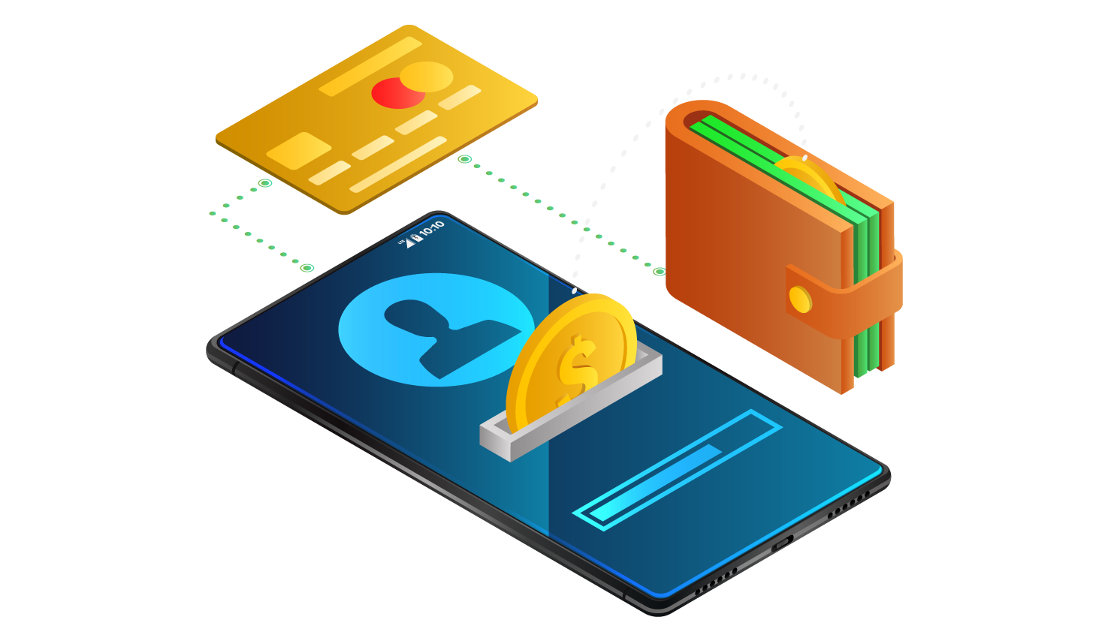
Objective
Dpay Wallet is created to meet the needs of online payment system, with 2 actors:
Customer: Create a account, Login, Add Money, Withdraw Money, Money Transfer, Print Transactions, Edit Profile, Change Password, Forget Password.
System : Register new Customer, Authenticate Customer, Save changes in Database.

Slide 3
Technology Stack
1. Presentation Layer:
-NodeJS 12.16.1 (Javascript Runtime Environment)
-Angular CLI 9.0.6 (framework to develop web apps)
-VSCode 1.44.2 (to develop front end)
2. Business Layer:
-Java 8 (base programming language)
-Postman 5.5.5 (for running RESTful service)
-Spring framework (for creating webservices)
Spring Boot 2..2.6.RELEASE (auto configuring)
3. Persistence Layer:
-Hibernate 5.4.12.Final (JPA implementation)
-Spring Data 2..2.6.RELEASE (performing repository ops)
-Oracle 11g(database storage)
4. DevOps:
-Maven 3.6.3 (Build & manage project)
5. Hardware and Software Requirements:
Windows 10, RAM 2GB, I.E 7+ or Google Chrome, Memory Space: 500MB.

Slide 4
Wallet-Services
Registration: Register a new user for wallet.
Login: Login as a customer in wallet.
Deposit Money: Add money in the wallet.
Withdraw Money: Withdraw money from the wallet.
Transfer Money: Transfer money from wallet to the other customer of the wallet.
Check Balance: Check available balance in the wallet.
Print Transactions: See the recent transactions done from the wallet
Edit Profile: Edit profile such as name, age , etc.
Logout: Logout from the wallet if logged in.

Slide 5
Scope of the Project
Design and implementation of digital payment service as Wallet.
A customer can create account in the wallet and can login as a customer and can logout.
All the mentioned wallet services can be carried out in the wallet with the help of Http requests.
The user can able to perform the mentioned operations.
There will be a homepage indicating wallet introduction.

Slide 6
Outside the scope of the Project
Providing the facility to edit the profile of existing customer.
Customer can restore password if forgotten by using Forgot Password Service.
The footer is added which indicates copyright.

Slide 7
Future Work
Social Media Integration
Link the bank account to the customer wallet.
Transactions should be done from bank account
Add money using debit card, credit card, net banking
facility.

Slide 8
THANK YOU

